Slide 1
BIENVENIDOS
Notes:
Zoom orientation slide

Slide 2
CREANDO AMBIENTES SEGUROS Salvaguardando a los Hijos de Dios
ministerios de bienestar y cuidado
Notes:
After welcoming people, be sure to give trigger warning, an example of which is below.
****TRIGGER WARNING****Do Not Skip
This is a place and time for us to talk about our community and the work we do together to create environments that are safe for children, youth and adults. I will do my best to make this a safe place for all of you, and I ask the group attending to also agree to make this a safe place for everyone.
Conversations about child sexual abuse can bring up emotions that are distressing and may be difficult to manage in the moment. If this is the case, we want you to know that you are free to participate to the extent that you feel comfortable. We trust that you know how best to care for yourself.
Sometime people choose to share personal experience. This is not a requirement to participate or an expectation of the training. If you choose to share a relevant, personal experience, please know that you can count on respectful listening and confidentiality. Any personal story shared here is private and not for use in future trainings.

Slide 3
NUESTRO COMPROMISO UNO CON EL OTRO
"A través del bautismo, compartimos una vida de fe común, una vida de servicio, una vida enraizada en el amor y la fidelidad. Prometemos en cada bautismo luchar por la justicia y la paz entre todas las personas y respetar la dignidad de cada ser humano. Estas promesas nos llaman a asegurar que nuestras congregaciones, escuelas y organizaciones sean lugares seguros para todos los hijos de Dios. Nos comprometen con nuestros mayores y mejores esfuerzos en nuestra vida común, incluido el cuidado y la seguridad de nuestros niños y jóvenes".
Notes:
This is a quote written by a Safeguarding minister some years ago. It can be replaced by a prayer from the BCP or another prayer, reflection or quote that best suits your audience.

Slide 4
PRESENTACIONES
Su Nombre
Comunidad y Papel / Responsabilidad
¿Por qué esta capacitación o información es importante para su comunidad?
Notes:
Introductions are a great way to help participants get comfortable interacting on zoom: Introductions can take up more time than you have planned, depending on the number of people joining the training. Remember to give clear instructions about what you want them to offer and the time they have in which to speak.
You can skip this step altogether if you are working with a group from the same location who probably already know each other.
An alternative is to have a quick icebreaker. Ask why this training is important to their community/ministry or consider a question such as “What good thing did you do for yourself today?”

Slide 5
DESCRIPCIÓN GENERAL
Parte 1: Creando Ambientes Seguros y Sanos
Descanso
Part 2: El Monitoreo & Supervisión
Part 3: Respondiendo a las Violaciones de las Pautas e Informarlas
Conversaciones de Grupos
Código de Conducta
Q & A (Preguntas y Respuestas)
Notes:
Let people know that it’s not possible, in the time allotted for the training, to cover all sections of this policy in depth. Remind them they need to spend additional time with the policies to familiarize themselves with those sections we don’t cover in full.
Remind them that the Safeguarding Team is available to discuss any policy questions.

Slide 6
¿POR QUÉ ENTRENAMOS?
¿Qué significa esta información para mí?
Notes:
Encourage participants to “look again” at their communities with an eye to assessing how safeguarding policies are implemented, what they do well and how things could be improved.
Remind them that the heart of our work and ministry is relationship and that relationships with children can be a catalyst for growth or distorted for self-gratification.
Remind them Episcopal institutions reflect the baptismal promises to seek and serve Christ in all persons, loving our neighbor as ourselves, to strive for justice and peace among all people, and to respect the dignity of every human being.
Goal is to provide safe, nurturing environments for all children, which is one way we live into these promises.
Training and adherence to policies demonstrates accountability to parents and to the communities where we work and volunteer.

Slide 7
ALGUNAS ESTADÍSTICAS
En los E.E. U.U., uno de cada diez niños será abusado sexualmente antes de la edad de 18 años.
-----------------------------------------------------------------------------
De todos los abusos sexuales a menores que se cometen:
• El 29% son por miembros de la familia.
• El 11% son por extraños.
• El 60% son por alguien que el niño conoce.
Notes:
We also train because we know reality of our culture. Child abuse is major health concern in our country and around the world.
Go over the statistics.
Focus on statistics on left. Name at least 3 things we can tell about a potential offender based on this information? Ask for responses before adding the following.
Someone who has gained the trust of the child
Someone who has gained the trust of the parent, guardian or organization
Someone with access to the child – may be considered a safe adult
Someone with opportunity to be alone with a child or to be unobservable
Now name at least 3 things that this doesn’t tell us about a potential offender. Ask them to respond – wait before prompting with some of the following:
Gender, age, religion, sexual orientation, race, socio-economic status, etc.
None of the characteristics we have mentioned, taken together or separately are any indication of whether someone is safe or not safe. The best tools we have at our disposal are an understanding of how an offender gains access to children, the ability to identify behaviors that an offender may engage in and awareness of our role in preventing abuse.

Slide 8
¿QUÉ ES LO QUE NECESITA UN OFENSOR?
Acceso
Privacidad
Control
Notes:
What conditions must be present of an offender to offend against a child. Access, Privacy and Control
Access –How does an adult gain access to a child? Solicit possible answers from 3 people
Finds jobs or volunteer positions that involve working with children (watch for frequent job changes)
Initiates contact with children offers to spend time even when it isn’t requested like picking them up from school
Engages children online
Overextends themselves by volunteering to give up personal time to tutor, babysit or spend time with a child, especially if parents are over extended.
Ask: How do offenders gain access to children or youth in a virtual world?
2. Privacy – Offender will look for opportunity to be alone with children.
Offers to take them to the bathroom
Offers private lessons
Meets in private spaces or staying late on a job or premises where there are children.
Discourages adults from participating in or monitoring activities with children.
Communicates privately with children – text, phone, FB, Instagram, or other social networking sites.
Ask: What are limitations an adult should place on their engagement with a child in a physical environment? In a virtual environment.
3. Control – How an offender isolates a child, makes a child emotionally dependent, and secures their loyalty so they won’t tell.
Encourages child to break or stretch rules
Gives special gifts – in secret – without permission or against parents wishes
Treats children as if they were peers (uses inappropriate language or swears, tells off-color jokes, talks to kids about personal topics)
Threatens or intimidates child.

Slide 9
LENGUAJE COMÚN
Las Políticas de Salvaguardando a los Hijos de Dios nos brindan un lenguaje común en nuestro trabajo de servir y proteger a los niños y jóvenes.
Notes:
EDOT policies: When it comes to the work of creating and maintaining healthy environments, our common language is found in our policies. Think of them as the framework for a house. They provide one of the foundational structures on which we build our ministries. Our common language consists of both verbal and physical interactions. We understand that most of what we communicate is comprised of what we do, how we act and interact, and how we agree to operate within certain boundaries that are appropriate for the settings where we work and volunteer.
By doing so, we are modeling behaviors that a child, a guest, a parent can recognize as behavior consist with the purpose of the organization. In practicing this common language, we are also better able to identify people who are operating outside of the boundaries we have determined to be appropriate.

Slide 10
DEFINICIONES, p. 5 - 8
A. Categorías por Edades
¿Quién es un adulto?
B. Personal: no solo empleados
Búsquese en la lista.
¿Su trabajo se incluye en más de una definición de Personal?
¿Hay alguna definición sobre la que sienta curiosidad?
C. Definiciones
Rol: ej., delator por ley
Comportamiento: ej., abuso entre compañeros
Identidad: ej., LGBTQ+
Actividades, programas: ej., fuera del lugar
Notes:
This section provides a common understanding of how specific definition & terms are used.
Policies require that adults supervise children and youth activities, which means we must define “adult” Go over definition.
Read definition of Personnel: Ask participants to find themselves on list.
Any surprises? (talk about key holders)
Suggest they read section for themselves later.
Terms aid understanding.
Mention that Gender is defined and discussed (e.g., cisgender and non-binary)
Roles are defined, including “Responsible Person.” (Discuss)
Activities are classified, like offsite, overnight, and travel, which affects level of supervision and monitoring required
Read the definition of abuse, page 7: Sexual abuse covers range of behaviors that may or may not involve physical contact. What are some examples of sexual abuse: Possible answers: inappropriate touching, exposure to child, anything done to sexually stimulate the adult

Slide 11
CREANDO AMBIENTES SEGUROS Y SANOS, p. 8 - 12
Normas de Comportamiento del Personal, p. 8 – 10
Comportamiento Sexual entre Niños / Jóvenes, p. 11
Necesidades Básicas, p. 11
Primeros Auxilios y Medicamentos, p. 11
Discriminación y Acoso, p. 12
Acoso, p. 12
Armas y Violencia, p. 12
Alcohol, p. 12
Notes:
Section describes how we create safe and healthy environments
Won’t cover every section. Up to participants to review, especially if leaders.
Everyone MUST understand Behavioral Standards
Spend some time on Behavioral Standards (including not being under the influence of alcohol, etc.)
Leaders need to review sections on basic needs and first aid and medications as they concern their programs
Policies aren’t focused only on preventing sexual abuse but on overall care of children
When properly addressed, all the above constitutes safe environment.

Slide 12
REFLEXIÓN
¿Cómo se ve y se siente la seguridad?
Notes:
Have participants reflect on their own childhoods and what made them feel safe.
Goal is to achieve that sense for children in our care.
Consider the vulnerability of children in their care
Why are some more vulnerable than others (minority in group, gender identity or sexual orientation, disability, family issues, socio-economic status)
What do they need to feel safe?

Slide 13
NORMAS DE COMPORTAMIENTO DEL PERSONAL, p. 9 - 10
4) No deberá involucrarse en comportamientos que cruzan los límites físicos, emocionales y de conducta
5) Relaciones privadas con jóvenes solo con permiso de los padres (ej., el uso de jóvenes como niñeras)
6) Tiene prohibido el uso, posesión, distribución, o estar bajo la influencia del alcohol, drogas ilegales
7) Tiene prohibido proporcionar a niños o jóvenes alcohol u otras sustancias prohibidas
8) Tiene prohibido tener contacto sexual con un niño o joven o involucrarse de manera sentimental
9) Tiene prohibido poseer, descargar o ver ningún material sexualmente orientado o explícito
10) Tiene prohibido discutir sus propias actividades sexuales
11) Tiene prohibido dormir con niños o jóvenes en la misma cama
12) Tiene prohibido usar cualquier forma de castigo físico
13) Tiene prohibido utilizar un lenguaje vulgar
Notes:
Please read the bolded section of the first paragraph in the policies on page 9.
#1 clearly states the expectation that Personnel will treat every child and youth with equal respect and consideration. We know children are vulnerable and that some life situations create greater vulnerability. What conditions may exist in a child’s life, their family or environment that can enhance vulnerability.
Examples – minority stress, gender identity or sexual orientation, disability, family issues, socio-economic status….
#2 states that one to one talks with children/youth will be conducted in a transparent and observable manner -
This is why we have standards. To identify and prevent. If every person who works with or around children is following the same standards, we are able to identify outliers, individuals who may be seeking their own gratification and those who are just not suited to working with children in this environment.
What message do we send to children when our behavior is consistent?
By following these standards, we are modeling behavior that is appropriate to this context and we are communicating to children, through our behavior, what a trusted adult looks like and how they behave.
What happens when we interaction with children in ways that are not consistent with standards. It is risky to act in ways that are not consistent with these boundaries because it creates confusion about how adults are supposed to act and that it may be ok to operate outside of the boundaries. We are communicating to other adults is that we are acting in concert.

Slide 14
LÍMITES SALUDABLES
Cómo crear ambientes seguros estableciendo límites saludables:
Físico
Emocional
Conducta
Notes:
Boundaries are a part of life. We have boundaries we aren’t even always aware of. Robert Frost wrote about fences making good neighbors. We use boundaries to limit our own behavior in different situations and we use boundaries to help define what are comfortable with and what we are not. We also cross boundaries every day, our own and other peoples boundaries. We extend a hand in welcome, we touch a friend’s shoulder in greeting, we also adjust our boundaries to accommodate a new idea, a new perspective to reach across a breach to try to resolve conflict. Jesus crossed boundaries to raise the dead and heal the sick and restore people to community. What is important here is that boundaries are what we establish – to keep us safe from physical harm or keep our distance from someone who may intend us harm; to keep us from behaviors that are risky, to protect our emotions and sense of self-worth.
In our work and volunteer settings we practice healthy boundary setting in our interactions with children/youth and have expectations

Slide 15
VIDEO: EL PATRÓN DEL “GROOMING”
Dr. Monica Applewhite, Ph.D., Directora de Confianza, LLC
Notes:
Ask for comments on what stood out for participants
“Grooming is the process of preparing a child or young person to experience relational sexual abuse without strong resistance or subsequent disclosure. It is a pattern of boundary violations intended to increase closeness, dependency, involvement and trust between the adult and the child he or she is targeting.” Monica Applewhite

Slide 16
RESUMEN DEL PATRÓN DEL “GROOMING”
Notes:
Summary Slide of video for discussion.

Slide 17
COMPORTAMIENTOS QUE QUIEBRAN LÍMITES - SEÑALES DE ADVERTENCIA
Cualquier forma de afecto físico no deseado
Los abrazos prolongados o inapropiados
Los besos en la boca
El sostener a los niños de más de tres años en el regazo
Compartir información personal o pedirles que compartan información con usted
Las demostraciones de afecto en áreas aisladas
El tocar las rodillas o piernas, o el “juego de las luchas” o cosquillas a los niños o jóvenes
Hacer bromas dañinas o aterradoras
Ser emocionalmente volátil con un niño / joven
Cualquier tipo de masaje brindado por un adulto a un niño o joven
Permitir que un niño / joven rompa las reglas de los padres o de la organización
Hacer comentarios o dar cumplimientos que se relacionen con el desarrollo físico o corporal
El dar regalos o dinero a niños o jóvenes individualmente
Exigir a un niño / joven que le dé afecto o atención
Interacción inapropiada por medio de las Redes Sociales
Notes:
Some boundary violations are observable – Some are more subtle
Identify a physical boundary violation from the list above.
What do you think an offender gains by violating a child’s physical boundaries?
Desensitizes child and adults to greater physical interaction
Child and adults may begin to believe the greater physical interaction is harmless
Identify an emotional boundary violation from the list above.
What does an offender gain by violating a child’s emotional boundaries?
Make the child believe they are the most special person in their lives
Create an emotional dependence (from video: children will often be made to believe that the offender cares deeply for them and that they are very special. Plays part in controlling child’s emotional life and minimizing chances that offender will be caught.
Identify a behavioral boundary violation from the list above.
What does an offender gain by violating child’s behavioral boundaries?
In getting child to break rules, they gain control of narrative – “you will get in trouble if you tell”

Slide 18
Discusión de Situación Hipotética 1
Ustedes son chaperones de un evento de jóvenes. Un voluntario de la edad de un estudiante de la universidad se sienta junto con una joven de la escuela preparatoria en el bus que los lleva al evento. Ustedes los ven hablando y pasando tiempo juntos durante el día. De camino a casa, la estudiante coloca la cabeza en el regazo del voluntario. ¿Cómo responderían?
Notes:
Review scenario and discuss answers.
Teachers often tutor or work with children on projects after class. Why is this a problem? What questions would you have?
Possible responses:
Is it in alignment with the school’s policies?
How are children selected for tutoring?
Who knows they are being tutored? Is the administration aware?
Are the parents aware and is there an agreement that the child needs tutoring?
Is there opportunity for casual monitoring exist?
This scenario is based on an actual situation. The teacher who invited children back into the classroom after school was sexually molesting the children. Many teachers voiced admiration for the teacher who was spending so much free time with children who needed extra help or attention. Some expressed concern about their own lack of extra effort, knowing that they needed that time after school to prepare for the next day. No one was familiar with the process of grooming.

Slide 19
COMO MOSTRAR AFECCIÓN APROPIADAMENTE, P. 9
Se alienta al personal a ofrecer formas de afecto apropiadas que respetan los límites físicos, emocionales y de comportamiento, incluidos, entre otros, los siguientes ejemplos:
El “dame cinco” o saludos con puño
El sostener las manos mientras se camina con niños pequeños
Breves toques de hombros, manos o brazos.
"Imposición de manos …" bajo supervisión pastoral apropiada
Breves abrazos y brazos alrededor de los hombros
Notes:
Have a participant read the section. Discuss some are all of questions below (as time permits)
What other ways do you have of showing affection to a child?
How do you show affection in a virtual setting? (Zoom class, tutoring, mentoring, etc.)
When is “appropriate affection not appropriate? Answer: When it isn’t wanted.
How do we know when a child does not want to be touched to show affection? Answer: may say something or show us in their body language (demonstrate)
Because of the power imbalance between children and adults and because children typically want to please, they may be reluctant to say no. It’s up to adults to be aware of what a child is communicating, whether by words, body language, reluctance, or resistance.

Slide 20
COMPORTAMIENTO SEXUAL ENTRE NIÑOS / JÓVENES
“Aunque no toda la actividad sexual entre niños o jóvenes es abuso, la actividad sexual de cualquier tipo entre niños o jóvenes no es apropiada en relación con actividades patrocinadas por la diócesis u organización, no importa dónde tome lugar. El personal debe intervenir para detener dicha actividad de un niño o joven e informarlo de inmediato como una violación de la política y es posible que deba informarlo como abuso.” p. 11
Reconocer cuál es la curiosidad natural y cuál es dañina
Tenga en cuenta los desequilibrios de poder, ej., niños mayores con niños más pequeños
Tenga en cuenta los lugares donde es más probable que tenga lugar la actividad sexual
Recursos: www.epicenter.org/safeguarding-trainers-corner/
Notes:
Curiosity about sexuality and their bodies is part of a child’s development
Characteristics of developmentally appropriate sexual behavior may include:
Occurs between children who have an ongoing mutual friendship
Occurs between children of similar size, age, social and emotional development
When adults set limits, children are able to follow the rules
Children may engage in harmful sexual behavior without understanding the impact on others.
Behaving sexually in a public place
A young child’s engaging in adult-like sexual contact with other children
Sexually harassing or intimidating behavior
Sexual interest in younger children or smaller children
Difficulty in stopping behavior when adults set limits
Whether the behavior is natural curiosity, intentionally harmful, or unintentionally harmful, the important 1st step is to interrupt the behavior without shame or harshness. Children need to know and respect boundaries about touching other children’s bodies.
Adults must report, either as a policy violation or as suspected abuse.
Offending against other children is not necessarily an indicator that a child will offend as an adult. https://www.ncjrs.gov/pdffiles1/ojjdp/227763.pdf
Stop It Now Tip Sheet - Age Appropriate Sexual Behavior
Stop It Now – Do Children Sexually Abuse Other Children
Center for Child Protection – Child Abuse & Neglect: The Impact of Trauma

Slide 21
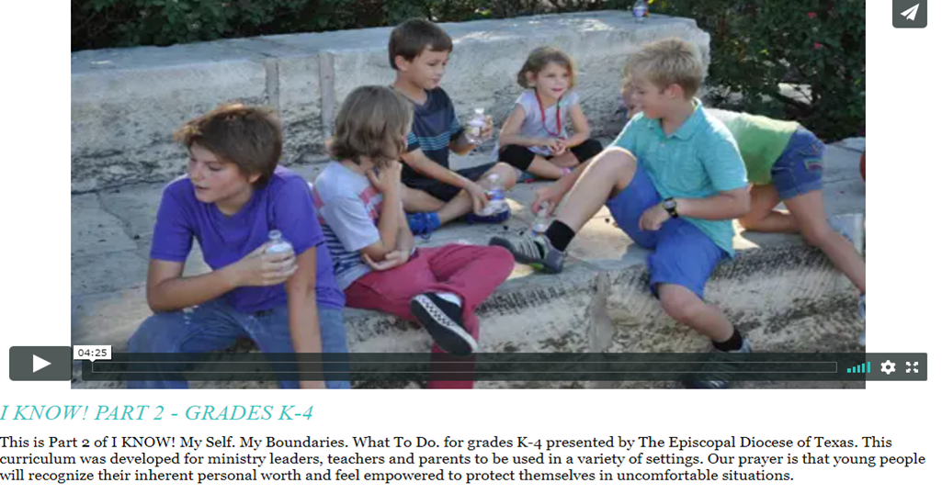
I KNOW: ENSEÑAR A LOS NIÑOS A MANTENERSE SEGUROS
La serie "I KNOW!" es un plan de estudios en línea diseñado para orientar a los niños y jóvenes para que se mantengan seguros: www.epicenter.org/i-know/
Notes:
Tell participants that children can learn what safe boundaries are for themselves, and how to respond if someone should not respect those boundaries. This is a FYI resource, and is only available in English at this time.

Slide 22
¿QUÉ ES EL ACOSO?
¿Cuál es la diferencia entre bromear y el acoso?
¿Cómo se ve el acoso?
¿Quién es vulnerable a ser acosado?
¿Adónde toma lugar con frecuencia el acoso?
¿Por qué es tan preocupante el acoso?
Recursos: www.epicenter.org/safeguarding-trainers-corner/
Notes:
Teasing may involve hurtful comments, taunting, or aggressive behavior, but what distinguishes bullying is that it is intentional, repeated and there is a power imbalance that could be age, size, or social standing. A child of smaller stature can be a bully, especially if they have the right skills, social power or position.
Bullying can be direct in nature such as physical acts of aggression and or verbal aggression. Can involve sexual abuse.
How else does bullying show up? Can be indirect such as isolating, rejecting, spreading rumors, or blackmailing
The reasons for being bullied most often reported include physical appearance, race/ethnicity, gender disability, religion and sexual orientation.
Adequate adult supervision is required in areas where bullying more likely to occurs.
Bullying most often occurs in the hallway or stairwell at school (425), inside the classroom (34%), the cafeteria (22%), outside on school grounds (19%), on the school bus (10%) and in the bathroom or locker (9%)
Students who bully others, are bullied, or witness bullying are more likely to report high levels of suicide-related behavior than students who report no involvement in bullying (Center for Disease Control, 2014).
Bullying should be reported within an organization. Contact Safeguarding Minister if you have questions.

Slide 23
CONOZCAN LAS SEÑALES DE ADVERTENCIA (que el abuso ya pudo haber pasado):
Físicas
Conducta
Emocionales
Notes:
Trauma is a subjective experience. Children interpret their unique experiences differently.
Responses to trauma are not in a child’s conscious control
Signs and symptoms of traumatic stress resulting from abuse may look different in each child and at different ages. Signs may emerge immediately, or they could emerge weeks, months or years later.
Important key is otherwise inexplicable change in a child’s behavior.
The following 3 slides discuss signs that are observable. When we see them, we should be able to say: I noticed this. Is everything okay? Would you like to talk about something? If child is not in trusting relationship to you, bring it to the attention of the Responsible Person or Program Supervisor.

Slide 24
SEÑALES FÍSICAS
Dolores de cabeza frecuentes, dolores de estómago
Interrupciones del sueno
Bajar o subir de peso
Dolor en el área genital
Dificultad al caminar o sentarse
Infecciones de la vejiga o vagina
Moretones
Embarazo
Notes:
Physical signs of sexual abuse are rarer than signs of other physical abuse and more difficult to identify.
Give participants chance to review the list. Point to 1 or 2 of these signs. Ask if anyone has questions or comments.
Point out that all signs of abuse must be reported to Texas Dept. of Family Services, whether or not there are signs of sexual abuse. (More about this subject in a minute)

Slide 25
SEÑALES CONDUCTUALES
Retraimiento de los amigos o de actividades regulares
Cambios abruptos en conducta o cambios con el desempeño en la escuela
Conocimiento sexual no apropiado para la edad del niño
Rebelde o desafiante
Daño a sí mismos o comportamiento riesgoso
Victimización sexual a otros niños
Notes:
Give participants aa chance to review this list. Point to 1 or 2 of these signs. Ask if anyone has questions or comments.

Slide 26
SEÑALES EMOCIONALES
Aflicción por abandono paternal
Cambios de humor
Irritabilidad
Malas retrospectivas
Inhabilidad de concentrarse
Pensamientos o intentos de suicidio
Depresión o ansiedad
Notes:
Give participants a chance to review this list. Point to 1 or 2 of these signs. Ask if anyone has questions or comments.

Slide 27
RESPONDIENDO A SEÑALES DE ABUSO POTENCIAL
Reconocer las señales
Conocer a los niños bajo su cuidado
Reportar: Ver o oír algo? Decir algo.
Hablar con el niño
Pregunta: ¿A veces, porque no reportan el abuso los niños?
Notes:
Ask why children may fail to report abuse
They may be afraid that they won’t be believed
They may be emotionally attached to their abuser
Young children may not have the language
May fear reprisal from their abuser
Knowing signs that may be indicators of sexual abuse is critical. Some signs are easy to overlook or explain away.
If concerned, talk to the child in non-threatening way.
Be aware of your tone. Keep conversation casual.
Ask questions in the child’s own vocabulary.
Don’t as if someone has “hurt you” because child may be attached emotionally to their abuser.
Ask if everything is ok. Ask if someone has been “touching you.”
Avoid judgement and blame.
Reassure the child that child’s not in trouble, not to blame.
See https://www.rainn.org/articles/if-you-suspect-child-being-harmed
If suspect abuse, report it.
Invite them to contact the Safeguarding Minister to talk through concerns.

Slide 28
DESCANSO & REPORTE
Notes:
Let participants know that there will be a check-in after this break and to consider what piece of the training has stood out for them and what they think will be most helpful in their work or ministry.
Ask: What stood out? What information has been most helpful for them in their work or ministry
After Check-In:
First half of training focused on creating safe environments by knowing and modeling appropriate interactions and by understanding how and where offenders operate.
Second half will focus on monitoring and supervision to maintain safety of these environments and to respond appropriately when policy violations occur.

Slide 29
MONITOREO & SUPERVISIÓN p. 13 - 22
“El personal debe monitorear y supervisar los programas para niños y jóvenes para que los comportamientos inapropiados de adultos, jóvenes y otros niños puedan ser detectados y detenidos. Las siguientes reglas se aplican ya sea si los programas tomen lugar en propiedades que pertenecen a la diócesis u organización, o no.”, p. 13
Notes:
Ask participant to read the slide.
Monitoring is how we keep ourselves and each other accountable for keeping our environments safe.
As in the previous section, won’t t be able to cover policies in detail. Convey expectation that they will read policies, particularly the ones that most impact their ministry and roles.

Slide 30
SUPERVISIÓN ADECUADA POR ADULTOS
En ambientes y eventos diseñados para niños y jóvenes
Para actividades privadas
Para ministerio virtual y redes sociales
Para eventos fuera del lugar, viajes, y eventos pernoctas
Notes:
Summary of what will be covered.

Slide 31
PERSONA RESPONSABLE
1) Una Persona Responsable es designada por un supervisor y:
a. está físicamente presente en el sitio del programa o actividad
b. es responsable del cumplimiento de las políticas de SGC.
2) Las responsabilidades especiales incluyen:
a. administrar medicamentos a menores
b. llevar los documentos necesarios para viajar
c. recibir informes de sospechas de abuso y violaciones de límites
d. asignación de habitaciones y ocupantes en caso de estadías en hoteles
Notes:
New to policies in 2020. Important that Program Supervisors and Heads of Organizations know of the changes.
Must be an adult who is screened and trained under these policies

Slide 32
SUPERVISIÓN ADECUADA POR ADULTOS (continúa), p. 13 - 15
Accesibilidad de información
Permiso y monitoreo de actividades
Persona responsable
La regla de dos adultos
Circunstancias imprevistas
Personas no relacionadas
Proporciones
Notes:
Requests for new activities must be submitted in writing to the head of the organization have written approval.
Policies must be posted where activities take place.
All activities must have an appointed Responsible Person.
Point out that schools or camps may follow accreditation and state licensing requirements. P. 14, G
Alert them to need to review special ratios for travel. P. 20, B
Ask what unforeseen circumstances they’ve encountered when supervising an event? Find themselves alone with one child? How did they respond in that situation.
Policies now address it: notify Responsible Person, Supervisor, and Head of organization as soon as possible. P. 14, E
Review: Who is considered an adult for the purposes of supervising children? Answer: An adult is one who is 18 years old and not in high school.
Must be two years older than the oldest participant
If have a high school program that is open to kids age 14 – 18 (or older if they are still in high school), can an 18 year supervise? No. The key is that it is open to all high school students.

Slide 33
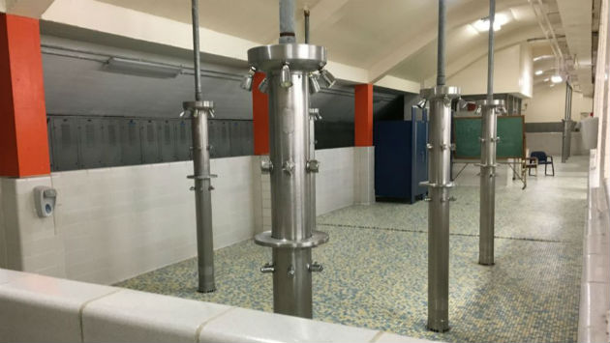
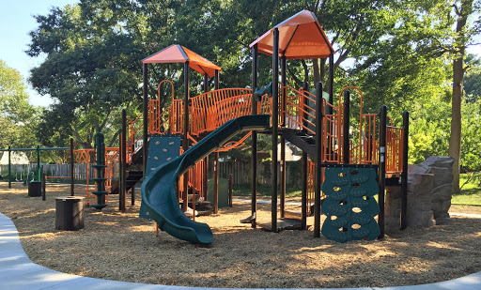
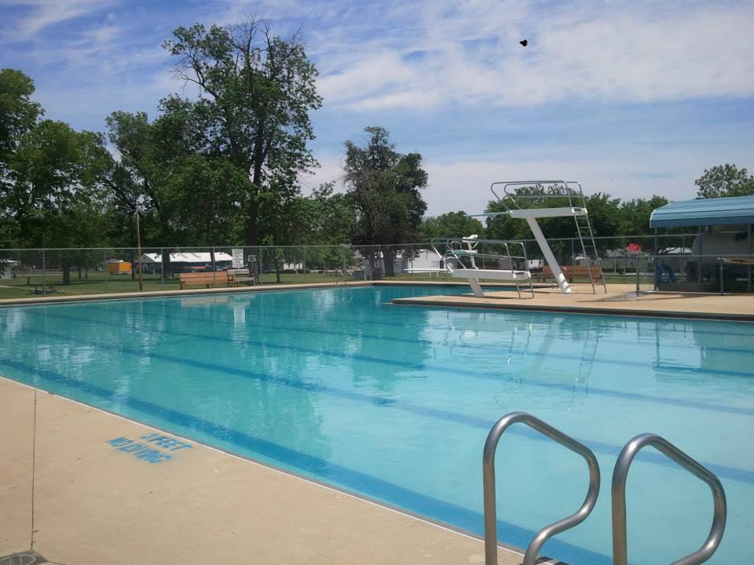
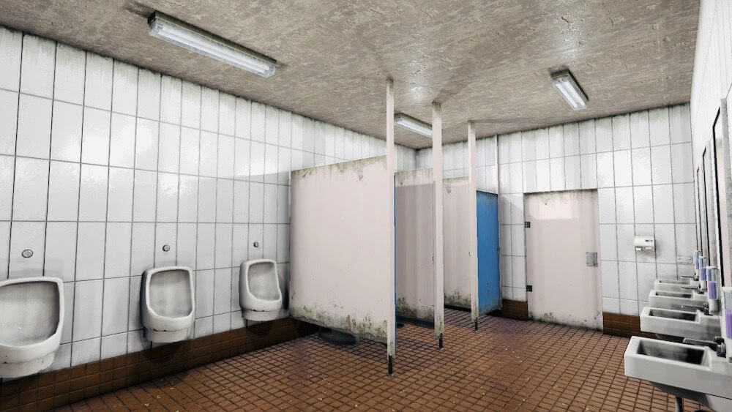
RETOS A LA SUPERVISIÓN
Notes:
Visibility is critical to supervising activities. What it takes to maintain appropriate visibility changes depending on setting.
Ask participants to recall the slide on bullying. Where were the challenges to supervision?
How do you position yourself in a room to make sure you see all the room?
Hint: Not in the middle
Ask participants to describe challenges they have in maintaining visibility in their programs.
Ask participants to look at the pictures on the screen and identify the area where harmful behavior is most likely to take place and why?
Restrooms – less supervision, children can be partially clothed
Showers – same issues
Swimming pools – same issues and younger children and older children may be together
Playground – obstructions, tendency to talk with other teachers
Nap time – same issues, including lower lights, children under covers
Ask participants what happens if they find themselves in a less than optimal situation such as being alone with a child or if an adult cancels. How do you maintain visibility?
Possible answers: Open doors, roving monitor, move location

Slide 34
SUPERVISIÓN ADECUADA POR ADULTOS, (continúa), p. 15 - 18
J. Actividades Privadas: supervisión de baño y otros áreas
K. Redes Sociales
2. Aceptar responsabilidad
a. La presencia del ministerio en las plataformas de las redes sociales deben tener más de un administrador adulto.
b. Programe todas las reuniones y clases virtuales con anticipación en un calendario que, junto con la información de inicio de sesión y las contraseñas, se comparte con los padres y el Supervisor.
d. La comunicación con niños y jóvenes … debe ser con grupos …
Notes:
Highlight bathroom policies on page 16, and Social Media policies on pages 17 and 18.

Slide 35
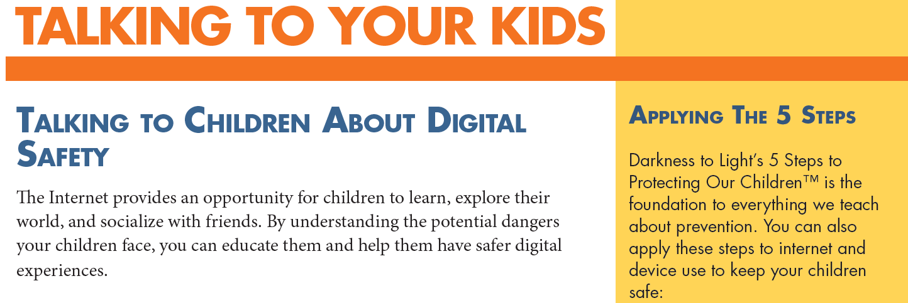
RECURSOS DE SEGURIDAD DIGITAL www.epicenter.org/safeguarding-trainers-corner/
Notes:
Point out that additional resources on digital security can be found at the Safeguarding Website, but only in English, at this time.

Slide 36
EVENTOS FUERA DEL LUGAR, VIAJES, EVENTOS PERNOCTOS, p. 19 – 22 ¿Cómo se ve la supervisión adecuada por adultos?
Notes:
What are the requirements if you have an off-site activity? - page 20, B. 1 & 3
Or driving? P. 21, D.1
Or travel? P 20, 1 & 2
Or overnight? P 22, E

Slide 37
REQUISITOS DE CERTIFICACIÓN, p. 23 - 27
Personal
Padres Voluntarios
Jóvenes Ayudantes
Acuerdo de Entrenamiento Únicamente
Proveedores y Socios no Episcopales en el Ministerio
Tutorers y Instructores Independientes
Notes:
Think back to conversation about the 3 things an offender needs. Discuss how screening and training may help one of those things from happening.
Point to screening and training requirements.
Point to exceptions for parents – 6 x rule
Depending on whether participants include Program Supervisors, Heads of Organizations, etc., you may need to spend more or less time on this slide.
Ask if anyone if they use outside vendors in their programs and point to the options for screening and training
Explain the difference between “training only” certification and full certification – both involve screening and training
Ask if anyone uses tutors or hires independent instructors. – What are rules for screening and training
Encourage calling Safeguarding Office with questions.

Slide 38
RESPONDIENDO A PREOCUPACIONES e INFORMAR
1) ¿Cómo respondemos a la sospecha de abuso? Llame al 911 o a Servicios de Protección Familiar (800-252-5400). p. 27, A
2) ¿Cómo respondemos a comportamientos que no son compatibles con las pautas? p. 28 B
Notes:
Regarding # 1:
In Texas ( not true of all states), we are all mandated reporters. If we suspect abuse of a child, must report that abuse to civil authorities. Reports to civil authorities may be made anonymously.
Reporting should offer objective information. What you observed or what you were told, identifying information about the child. Sample reporting form is on SG webpage but isn’t required.
Anyone who has reason to suspect child abuse of any kind (not just sexual) should make a report even if not certain . For guidance as to what is cause for reasonable suspicion, see the Child Protective Services Guide provided by childwelfare.gov.
Know signs that suggest abuse: welts on the back of the legs v. bruising on knees or elbows, bruising that is in outline of hand, teeth marks, etc.
For more information about detecting signs of trauma see recorded webinar at:
https://centerforchildprotection.org/services/education-services/
As with boundary or policy violations, must also report to the appropriate person(s) in your organization. Do not need to report to anyone who is the subject of the complaint.
If head of organization or any diocesan employee, report directly to the Safeguarding Minister or Canon to the Ordinary.
Point participants to the page with names and contact information.
Regarding # 2, point out that boundary violations and policy violations call for a different response to be discussed and a different kind of reporting, with this report going to an appropriate person, as outlined in the policies.

Slide 39
RESPONDIENDO A VIOLACIONES DE LAS PAUTAS
1) Interrumpir el comportamiento.
2) Usar la conversación de tres partes.
3) Informar: Ver o oír algo? Decir algo.
(Persona Responsable, Supervisor, Guardián, Líder de la Organización)
Notes:
Contact information must be posted where activities for youth and children take place, along with policies.
Ask participants to name some of the boundary violations they may see in their programs.
People to whom you may report – RP, Supervisor, a Warden, Head of the organization. Tell participants to read reporting section of policy for themselves. Head must know so that the violations can be addressed.
Must let Head know of violation unless Head is object of reported violation, in which case may bypass Head and report directly to SG Minister or Canon to the Ordinary.
Reports should always be objective, without supposition or speculation.
The following slides talks about interrupting behavior that is inappropriate and offering a teaching moment.

Slide 40
CONVERSACIÓN DE TRES PARTES 1) “He notado que le estabas haciendo cosquillas a Roberto.” (Describir el comportamiento) 2) “Tenemos que recordar nuestras directrices que nos piden que no le hagamos cosquillas a los niños bajo nuestro cuidado.” (Recordar a la persona la pauta) 3) “Hay mejores maneras de mostrar afección como ofrecer saludos de puños o pretender a hacer cosquillas.” (Surgerir una alternativa)
Notes:
Always interrupt behavior when it is happening.
Follow-up conversation is appropriate when the boundary violation that doesn’t rise to the level of suspected abuse--an opportunity to train in the moment. DON’T WAIT UNTIL THE NEXT TIME
Be specific about you observe without judgement or blame
Set a limit by making sure that the individual is aware of the specific policy they were violating.
Third step makes clear what is expected in future.
Refer to the 1st scenario. What would 3 step conversation have involved? What if boundary violation had been repeated?

Slide 41
Discusión de Situación Hipotética 2
Ustedes están trabajando en una escuela. Están conscientes que una maestra está invitando a ciertos niños a tener tutoría privada en el aula de clases después de la escuela. Otros expresan admiración a la dedicación de la maestra, pero ustedes se sienten incomodos con la situación.
¿Cuáles son algunas señales que puedan estar causando sus incomodidades?
¿Cuáles preguntas harían sobre la situación?
¿Cómo responderían?
Notes:
Break into small groups if appropriate to discuss the scenario.
What policies address this scenario?
Showing favoritism- spending time exclusively with one child
Having a child over the age of 3 in your lap
Does it matter what sex/gender the youth and chaperone are? (No)
How do you address this situation using the 3-part conversation?

Slide 42
CONVERSACIÓN DE GRUPOS ¿Cuáles son algunas razones por la cual adultos no reportan violaciones de las pautas?
Notes:
Why would we fail to report observed violations of policy?
Might make excuses for someone’s behavior, especially if we think the person’s motives for behavior were innocent
Don’t like conflict
May not know the policies well or understand the reason for standards of behavior
Someone we know and trust might be involved.
Why would we fail to report suspicions of abuse or neglect based on observation or report?
Might not be certain and don’t want to create problems.
Might not think it’s our responsibility.
Difficult to imagine someone hurting a child, so we may dismiss what we saw or heard.
Might not believe what a child is reporting

Slide 43
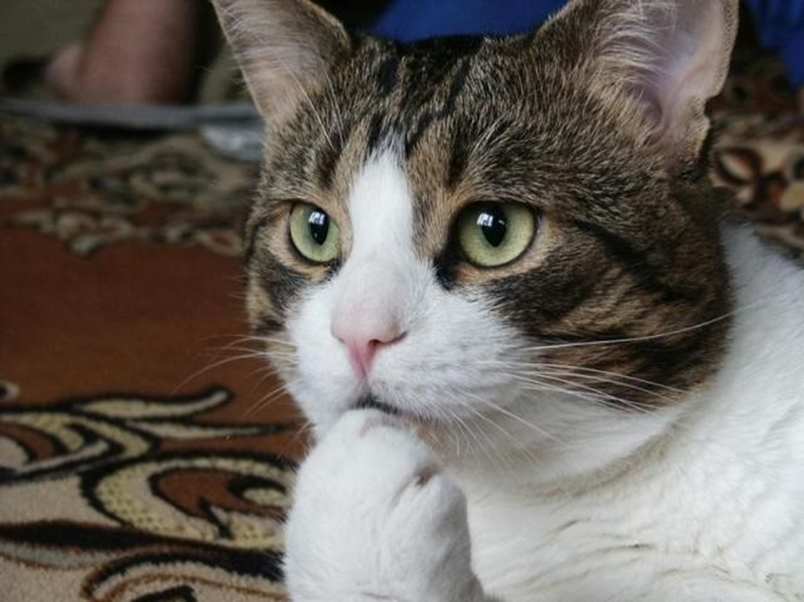
CONVERSACIÓN DE GRUPOS 2 ¿Hay algo que haría de diferente manera en su ministerio o trabajo como resultado de lo que ha aprendido hoy? ¿Puede dar un ejemplo? O, ¿Le gustaría compartir algunas observaciones o impresiones de lo que ha aprendido hoy?
Notes:
Concluding Breakout Conversation

Slide 44
CÓDIGO DE CONDUCTA
Siguiendo el mensaje del chat, escriba su nombre completo:
No abusaré física, sexual o emocionalmente ni descuidaré a un niño o joven.
Haré mi mejor esfuerzo para prevenir el maltrato y negligencia de los niños y jóvenes que forman parte de actividades y servicios de las congregaciones, escuelas y organizaciones de la Diócesis Episcopal de Texas.
Cumpliré en espíritu y en acción con estas Políticas para Proteger a Niños y Jóvenes del Abuso.
Informaré inmediatamente mis observaciones de comportamientos inapropiados o violaciones de límites como se indica en estas políticas.
Estoy de acuerdo en informar de inmediato el abuso o sospecha de abuso a las autoridades estatales y diocesanas.
Buscaré inmediatamente el asesoramiento de la Oficina de Salvaguardando si tengo alguna pregunta o inquietud sobre estas políticas o sus expectativas.
Notes:
Ask participants to read the code of conduct out loud, together.
Pass around the sign-out sheet, if in person training. Can have people put their name in chat box to indicate agreement if a Zoom training.
Final questions – Prayer at the end if desired.

